Slide 1

PT-2 REVIEW PRESENTATION
Under Guidance of- Mr K. Rajasekharam
Scientist “G”, DASQA, DRDL, Hyderabad.
By- Sunny Choudhary Muppala (38110340)
DETECTING PARKINSON’S DISEASE- using Modern ML algorithms

Slide 2
Contents
Certificate
Introduction
LITERATURE REVIEW
Methodology
Conclusion and Scope of Improvement
References

Slide 3

Certificate

Slide 4
Introduction
AIM OF THE PROJECT
The goal of this project is to build a model to accurately predict the presence of Parkinson’s disease in an individual.
What is Parkinson’s Disease?
Parkinson’s disease is a progressive disorder of the central nervous system. It is a chronic and progressive disease.
Why detecting Parkinson’s disease is so important?
If Parkinson predicted in its early stages, then it helps to save the lives.

Slide 5
LITERATURE REVIEW
Richa Mathur et al [23] suggested a method for predicting the PD. They used a weka tool for implementing the algorithms to perform preprocessing of data, classification and the result analysis on the given dataset. They used k-NN along with Adaboost.M1, bagging, and MLP. It was observed that k-NN + Adaboost.M1 yielded the best classification accuracy of 91.28%.
A.Yasar et al [24] used artificial neural networks for the detection of Parkinson’s disease. The dataset was taken from UCI machine learning repository. Using the MATLAB tool, 45 properties were chosen as input values and one output for the classification. Their proposed model was able to distinguish the healthy subjects from the PD subjects with an accuracy of 94.93%.

Slide 6
LITERATURE REVIEW
Max A. little et al [15] suggested a novel technique for the classification of subjects into Parkinson diseased and control subjects by detecting dysphonia. In their work, pitch period entropy (PPE) a new robust measure of dysphonia was introduced. The data was collected from 31 people (23 were PD patients and 8 were healthy subjects) which comprised of 195 sustained vowel phonations. Their methodology consisted of three stages; feature calculation, preprocessing and selection of features and finally the classification. For the classification purpose, they used linear kernel support vector machine (SVM). Their proposed model achieved an accuracy of 91.4%.
To separate the healthy subjects from PD subjects, Ipsita Bhattacharya et al [20] used a tool for data mining known as weka. They used SVM, a supervised machine learning algorithm for the classification purpose. Prior to classification, the data preprocessing was done on the dataset. Different kernel values were used to get the best possible accuracy by applying libSVM. The linear kernel SVM produced the best accuracy of 65.2174%, whereas the RBF kernel and polykernel SVM achieved the accuracy of 60.8696%

Slide 7
Methodology
Algorithm used:
We used the XGBoost algorithm. It is a new algorithm for Machine Learning developed with speed and efficiency in mind and is focused on trees to make decisions.
How XGBoost works:
The algorithm goes on by sequentially building more weak learners, each one correcting and reduce the errors of the previous tree until a stopping condition is reached.
Advantages of XGBoost:
Better Speed and performance
Regularization
Parallel Processing
Wide variety of tuning parameters

Slide 8
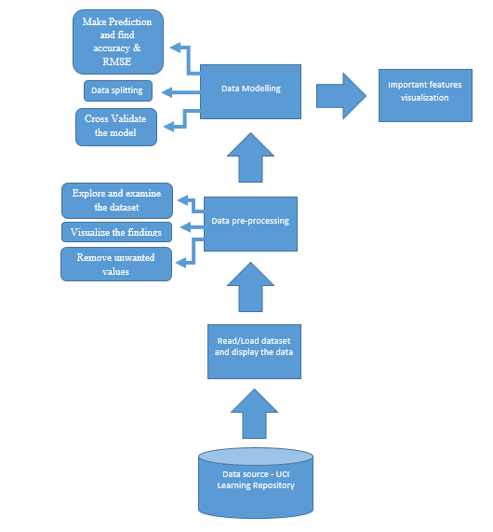
Detecting Parkinson’s Disease work-flow diagram

Slide 9
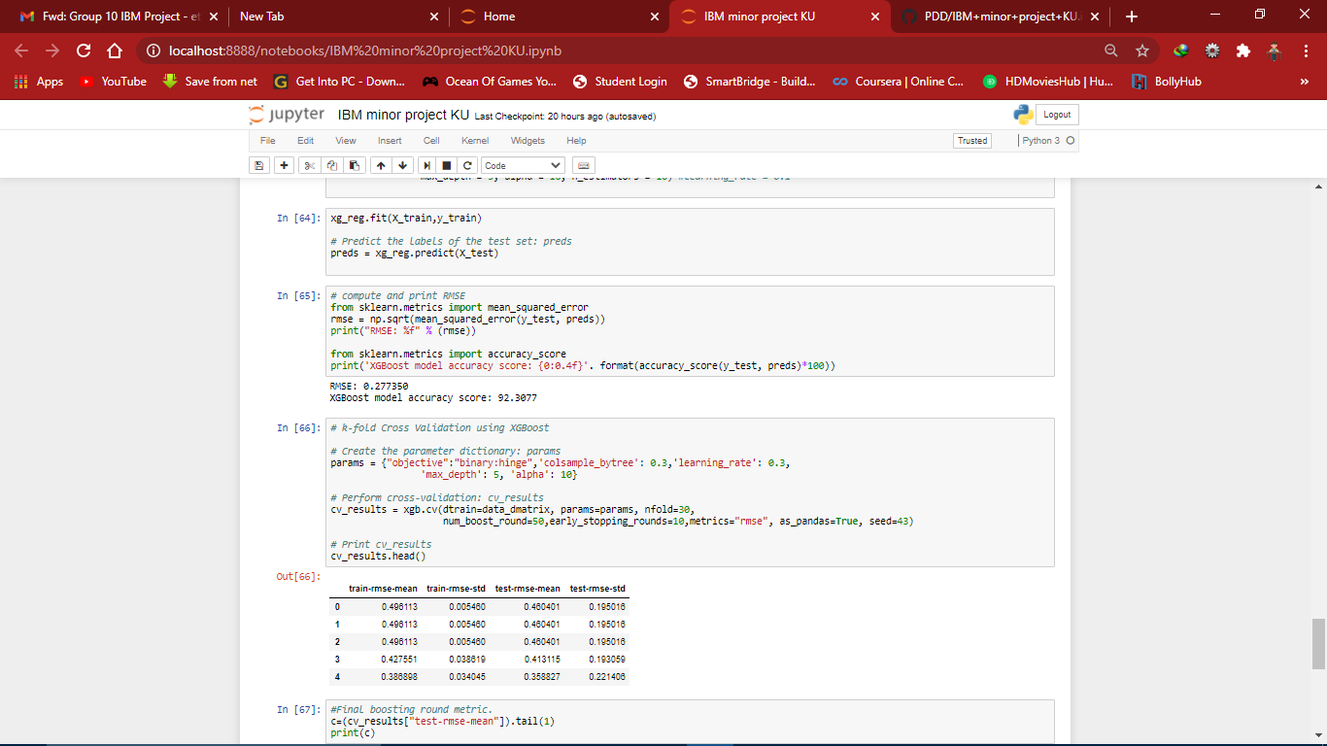
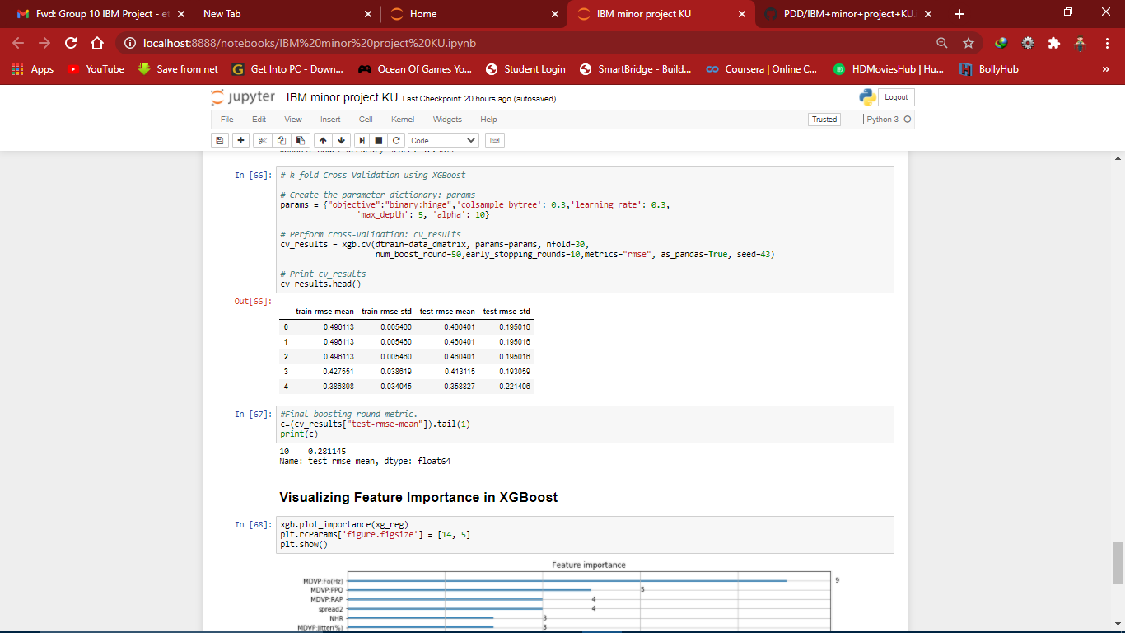
Outputs
An accuracy of 92.3077% was provided by the machine learning model with Root Mean Square Error of 0.277350.
On computing the k-fold cross validation of the model. The model gives Average Test RMSE of 0.281145, which is very close to the RMSE given by our model initially.
Screenshot 1.2: Accuracy and RMSE of
the model
Screenshot 1.3: test-RMSE-mean of k-fold cross-validation

Slide 10
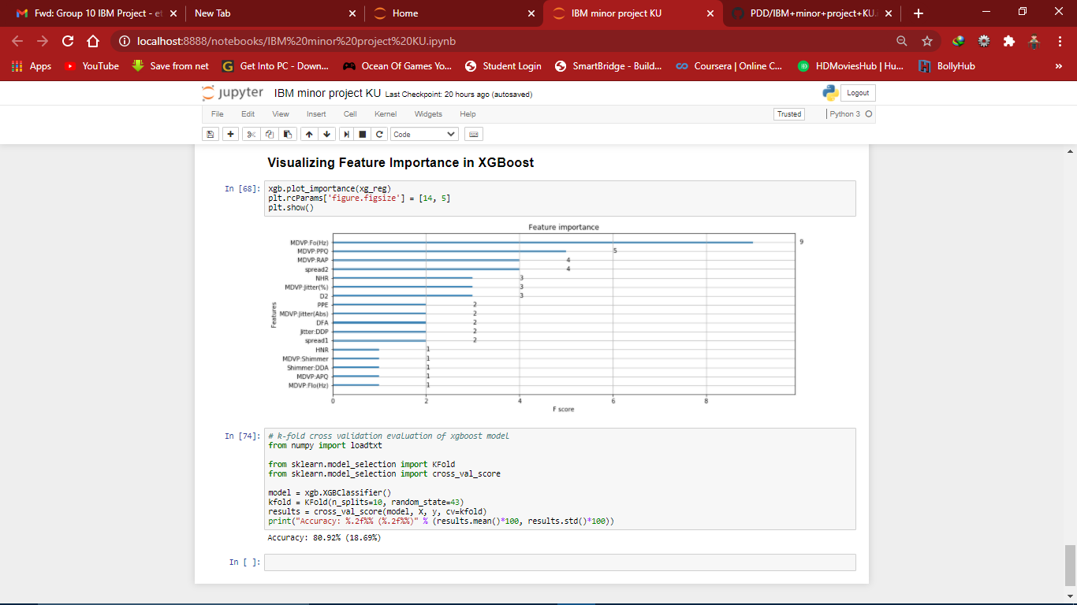
Outputs
Feature MDVP.Fo(Hz) (i.e. Average vocal fundamental frequency) has been given the highest importance score among all the features.
Screenshot 1.4: Feature-importance vs F-score

Slide 11
Conclusion and Scope of Improvement
The proposed model is a reliable model to detect Parkinson’s disease due to its efficient accuracy rates.
Though the model works efficiently, this is limited by the richness of the dataset with which it is being trained. The selected dataset, has only 197 instances, hence a dataset with more no of samples would help the model generalize better.

Slide 12
References
https://www.kaggle.com/prashant111/xgboost-k-fold-cv-feature-importance
https://randerson112358.medium.com/ai-in-health-2e9f84906bed
https://www.datacamp.com/community/tutorials/xgboost-in-python
https://codeburst.io/using-python-to-detect-early-onset-parkinsons-disease- b89651b0ed3
Sakar, C. O., & Kursun, O. (2010). Telediagnosis ofParkinson’s disease using measurements of dysphonia.Journal of medical systems, 34(4), 591-599.
Rahn III, D. A., Chou, M., Jiang, J. J., & Zhang, Y. (2007).Phonatory impairment in Parkinson's disease: evidence
https://www.datainsightonline.com/post/xgboost_predicting-parkinson-diseases

Slide 13
References
8. D.J. Gelb, E. Oliver, and S. Gilman, “Diagnostic criteria for Parkinson disease.” Archives of neurology, vol. 56, no.1, pp. 3999.
9. R. Das, “A Comparison of multiple classification methods for diagnosis of Parkinson disease.” Expert Systems with Applications, vol. 37, no. 2, pp. 1568-1572, 2010.

Slide 14
THANK YOU!!

